Slide 1
Case Study in Video Analytics
Cricket Shot Prediction

Slide 2
Contents
Cricket Shot Prediction – Objective and Formulation
Cricket Shot Prediction – Model Training and Testing
Challenges in Learning from Videos
Approaches to building Classifiers from Video data

Slide 3
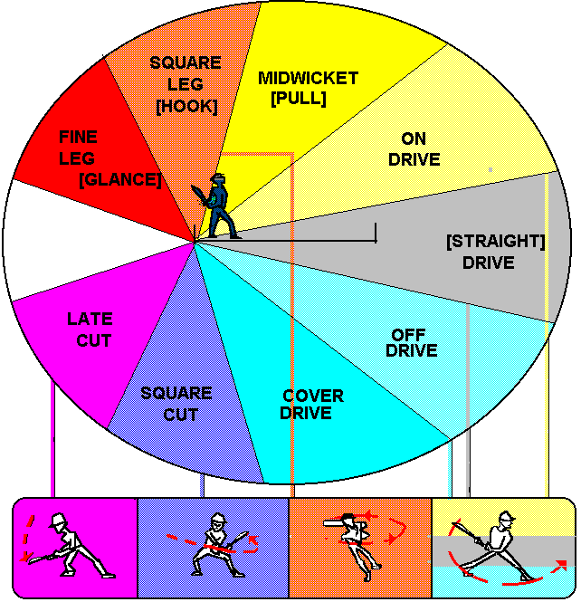
Cricket Shot Prediction
In cricket, various types of shots played by a batsman are identified
Drive
Leg Glance or Flick shot
Sweep Shot
Pull Shot
Hook
Cut Shot
Objective: Developing a cricket shot prediction model using video analytics
Videos of the batsmen playing a shot are used as input

Slide 4
Formulation
Formulation: Classification problem with each type of shot considered as a class
Relation between video and class of shot to be learnt from data
Classifier
Input-Output Relation
Output class
(Type of cricket shot)
Input
(Video of batsman playing cricket shot)
Feedback: Input-Output data

Slide 5
Step 1: Data Collection
Data Collection
Collect relevant data along with class label

Slide 6
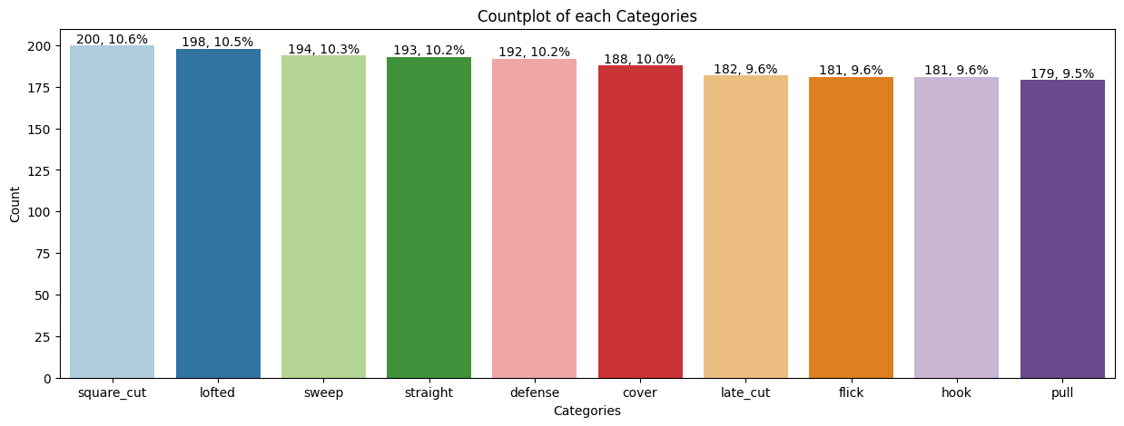
Dataset
Dataset is taken from a research paper (Link)
Dataset includes 1888 videos of 10 different cricket shots (10 classes)

Slide 7
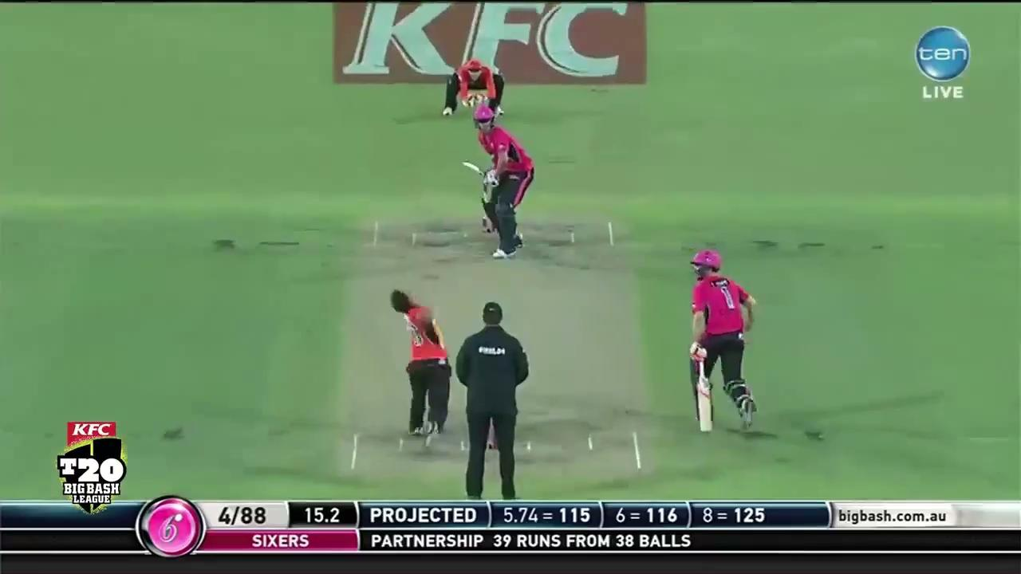
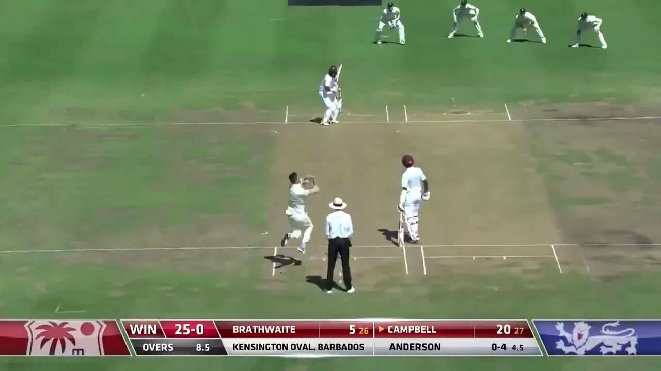
Sample Videos from Dataset
Cover Shot
Defense Shot

Slide 8
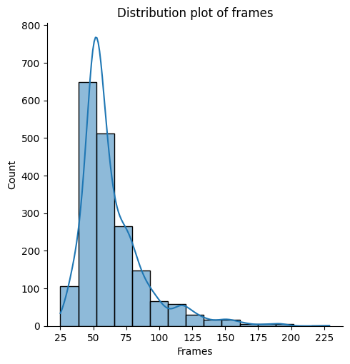
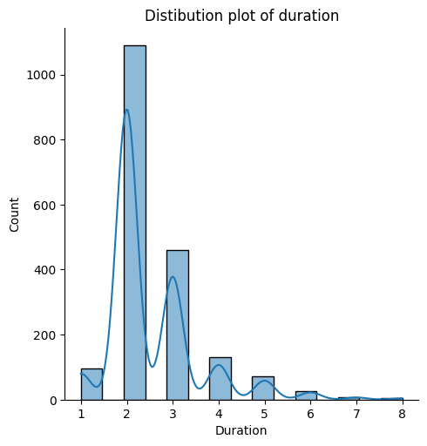
Distribution plot of frames and duration
Most videos contain 40 to 70 frames with 2 to 3 sec duration

Slide 9
Step 2: Data Preparation
Data Collection
Collect relevant data along with class label
Data Preparation
Clean the data and fill any missing values
Pre-process the data as necessary

Slide 10
Data Processing
Split the dataset, in a stratified manner, in the ratio of 80:20 for training and testing
Training set contains 1510 videos
Test set contain 378 videos
Size of training set not sufficient to train a good classifier
However, it is hard to generate synthetic data in this scenario

Slide 11
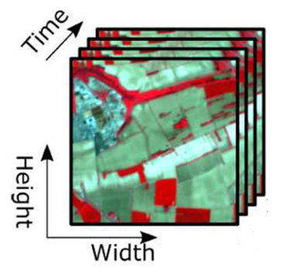
Video is Collection of Multiple Images
Video is a sequence of images (called frames)
Sequence of images are displayed at certain frequency (fps) to make it appear like a video
Videos contain 4 dimensions of data:
3 special dimensions representing the pixel values of shades of red, blue and green
1 time dimension representing the duration of the video

Slide 12
Step 3: Build Classifier
Data Collection
Collect relevant data along with class label
Data Preparation
Clean the data and fill any missing values
Pre-process the data as necessary
Build Classifier
Train classifier by learning relation between input features and output classes

Slide 13
Challenges in Learning from Videos
Spatio-Temporal dimensions: For tasks involving videos, the computer must learn spatio-temporal context across frames of the video which is a very complex task
Variability in Scale and Perspective: This learning should include thevariabile in scale and perspective due to camera movement
Large Data Size: Videos can be of high resolution and may run into several minutes or hours of duration resulting in vary large file sizes
Limited labelled data: Many videos with suitable content, duration and labels are hard to obtain
Long-Term Dependencies: Capturing long term dependencies is crucial in understanding the context in some cases

Slide 14
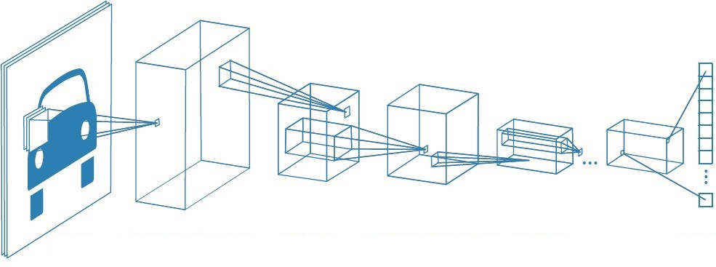
Convolution Neural Network
Convolution Layer
Convolution
layer
Pooling
layer
Pooling
Layer
Flattening
Input layer
Relevant features can be extracted from an image using a CNN

Slide 15
Approaches to Building Classifier on Videos
Frame Based Approaches
Sequences Based Approaches
3D CNN based Approaches
Attention Mechanism based Approaches
Different architectures have been developed based on each of the above approaches to learn from videos

Slide 16
Summary
Predicting type of cricket based on Video of a batman playing a cricket shot can be formulated as a Video Classification problem
Data collection involves collecting videos of different types of cricket shots played by different batsmen
Spatio-Temporal challenges need to be handled while extracting information from videos
Different types of approaches have been proposed to build classifiers which can handle the spatio-temporal challenges

Slide 17

THANK YOU

